Slide 1

Aptly Tech Proposal - Responding to Iris Support RFP

Slide 2
Current Support Process
Email Iris Support Alias,
Create ticket, with ID
Check inbox, - in email, read email, figour Core, Commers, segmentation (targets users) segrated to interaction (how you target, 10% or 100% and how often, schedule time span and period such as each day) or Insights,
User Monitoring interaction- they can see in Iris Studio. How many account, target, users were sent to
Reply, go to ticket system check subject, grab email
Reply with first responds
Investigation:
1, Campaign does not showing, showing correct accounts, 2000 user, next day 500 user, Iris platform, information correct
2, Iris Prove tool, more information about campaign, interactions, users, what happy to the users.
internal platform to check the campaign, dop counts,
3, how many users
How many dropped out users,
How many were set in Salesforce.
If everything matches, cannot find wrong, escalate to T2.
Reply back with the information found,
If not, need involve more people. T2,
Sending finding, answer back to call,

Slide 3
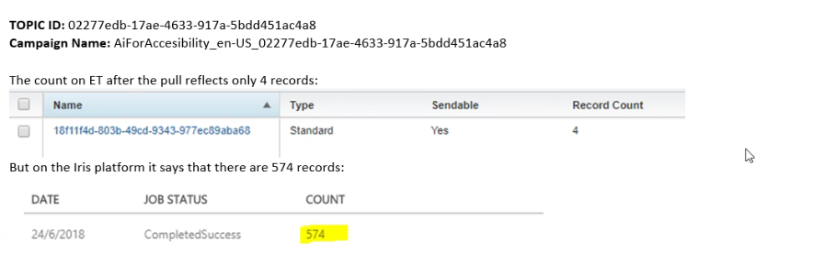
Current support work-flow
Cosmos, when some one is asking they query a string, a campaign or interaction, they want to looking for.
CAP Customer Assistant Portal
Cors and COMMS
Interaction FILTER engineer workers, provide work around.
Partner does not know CORS or COMMS
Douplcate , if user does not response, if no ID was added. Close, Ping customers, if still not response then close,

Slide 4
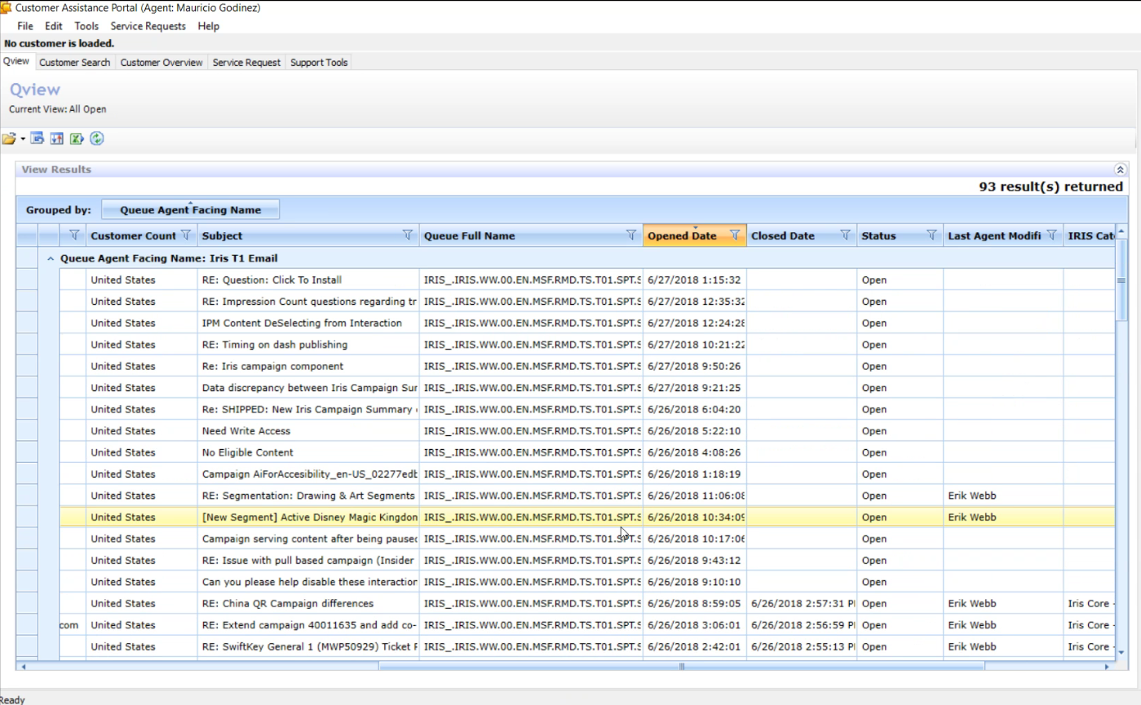
Understanding of the system

Slide 5
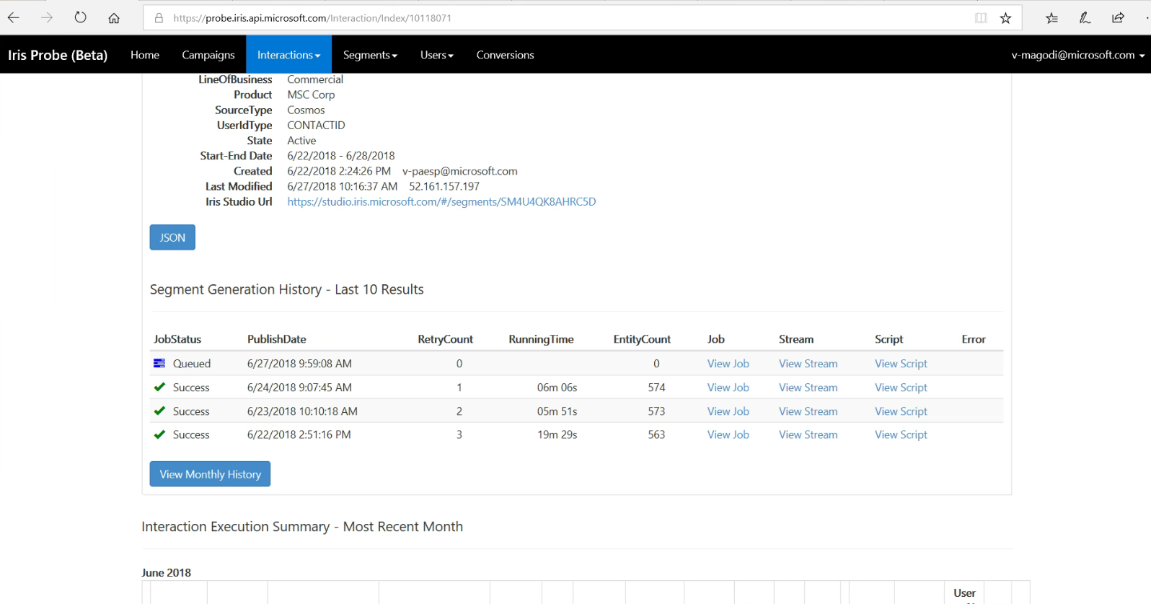
Current understand of Pain Points

Slide 6
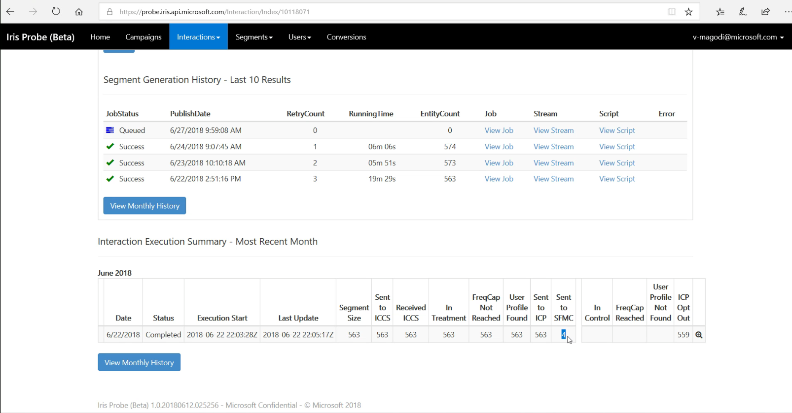

Slide 7
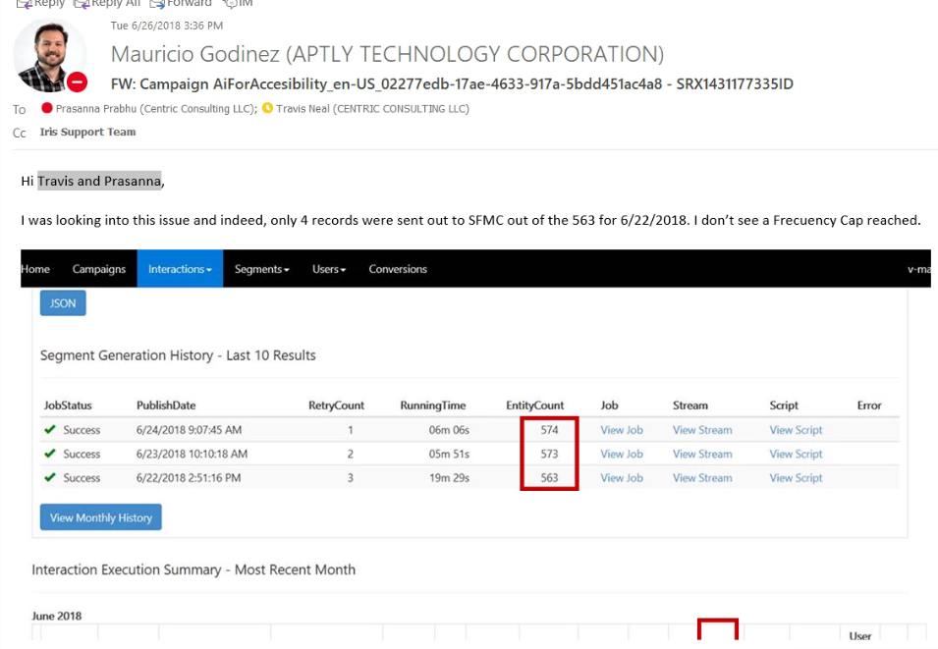

Slide 8
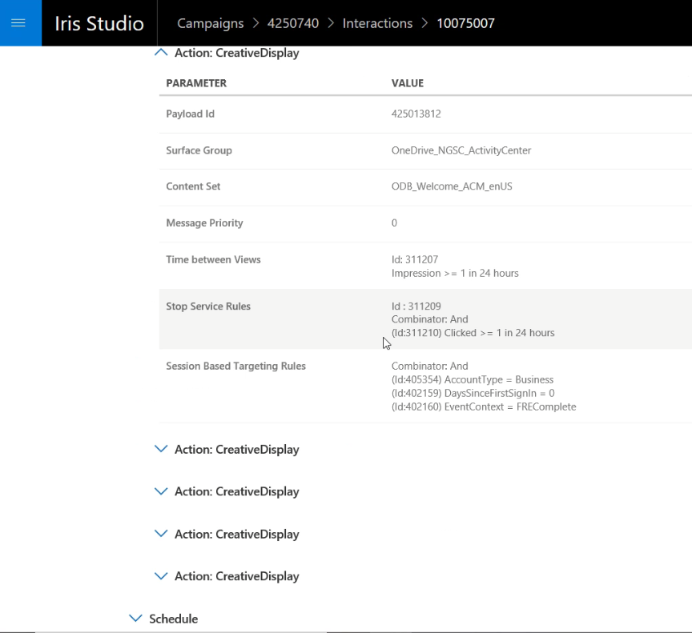
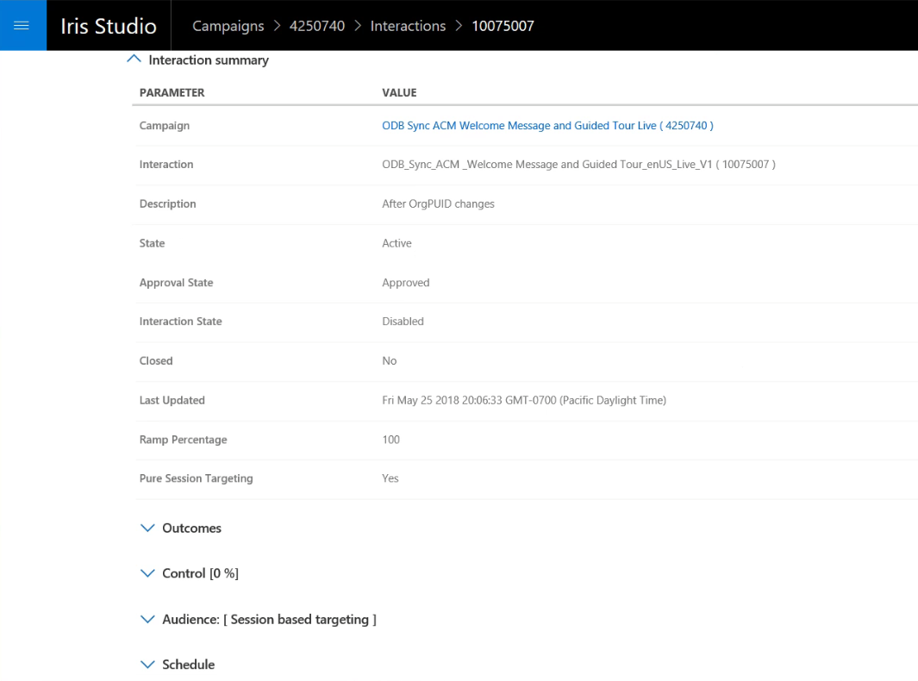
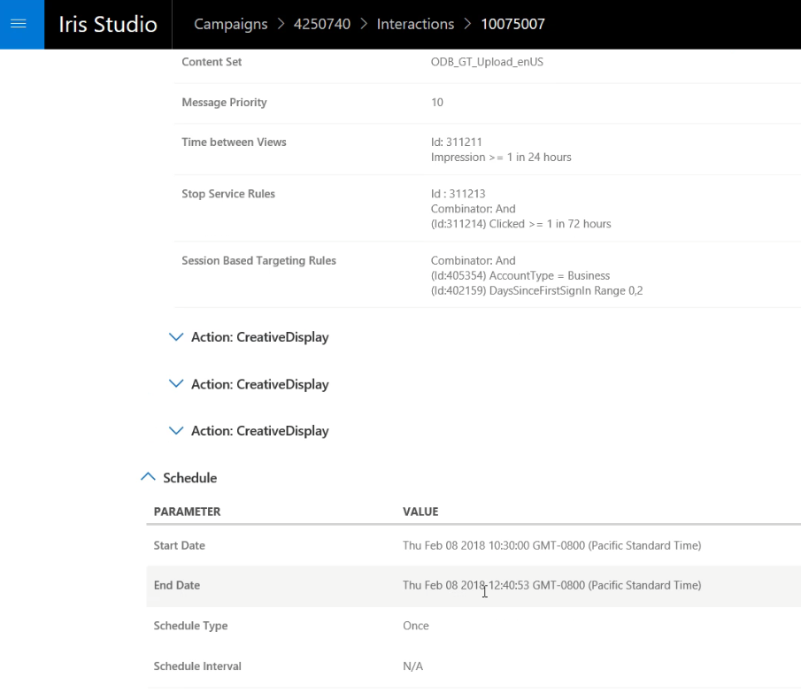

Slide 9
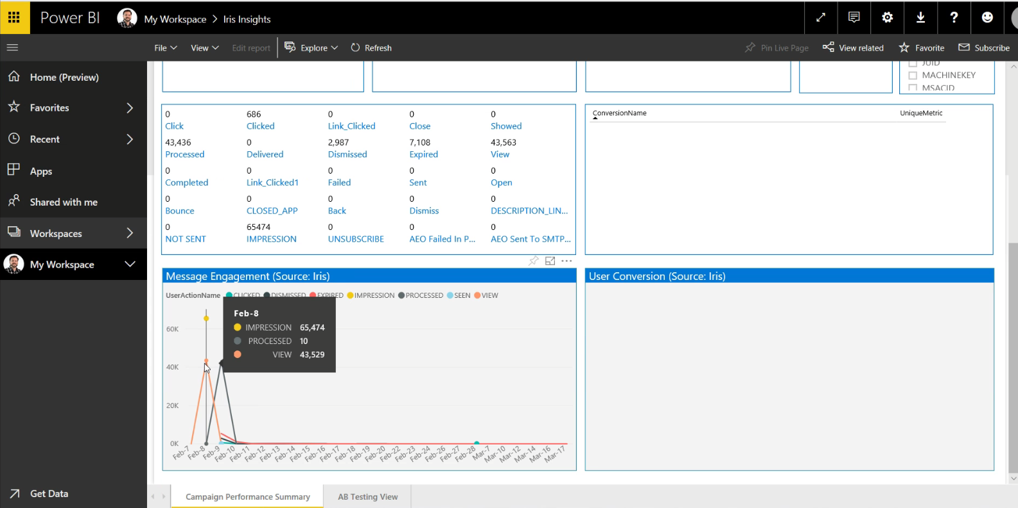

Slide 10
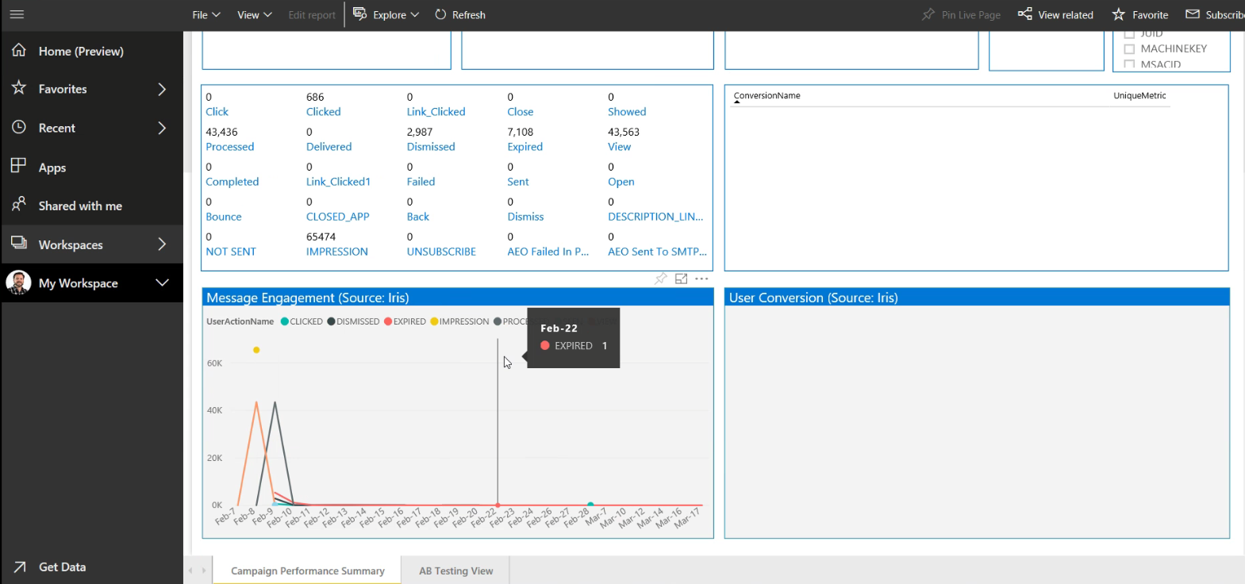

Slide 11
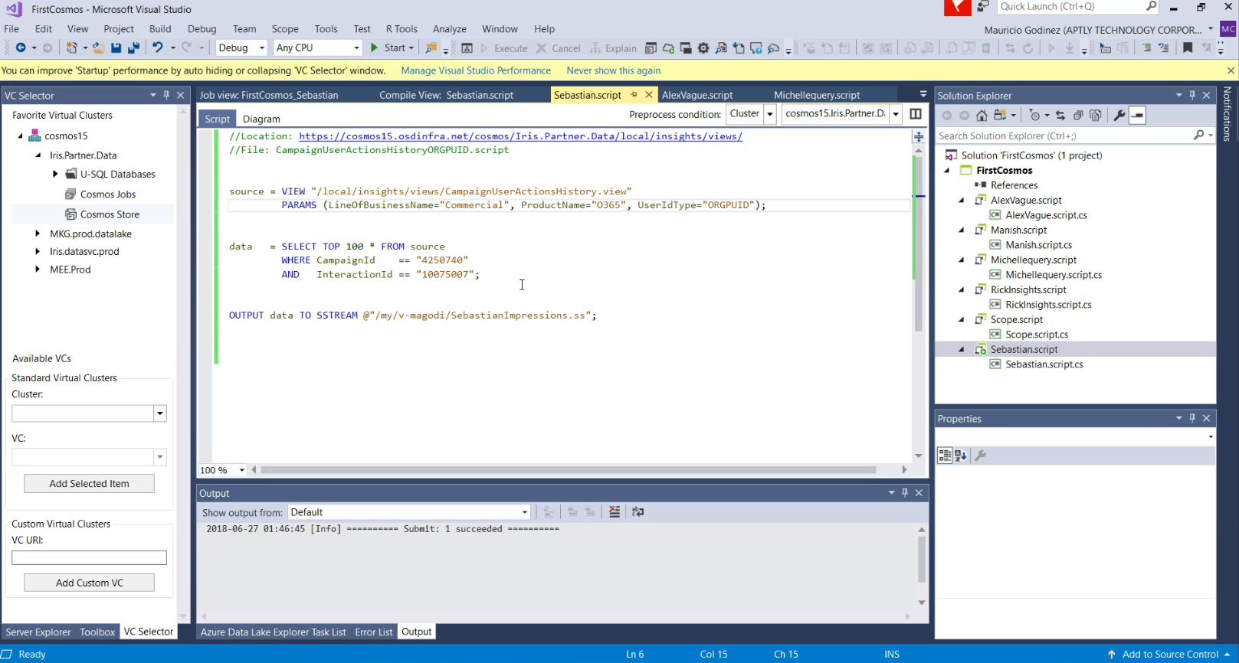

Slide 12
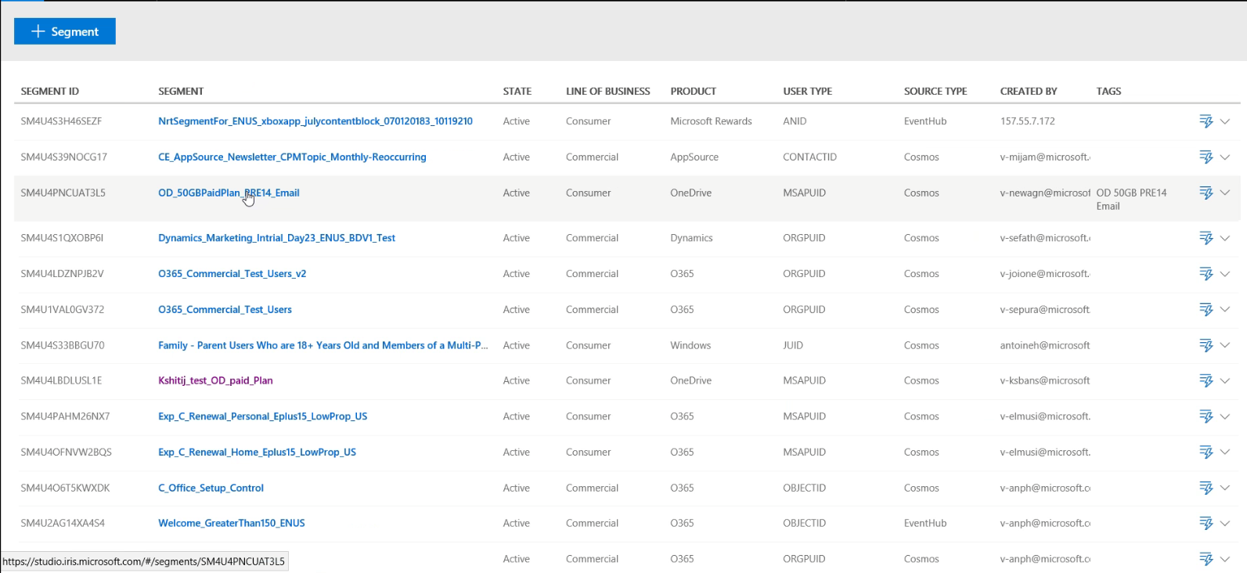

Slide 13
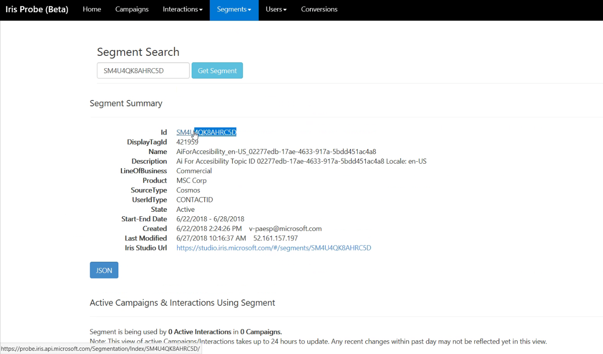

Slide 14
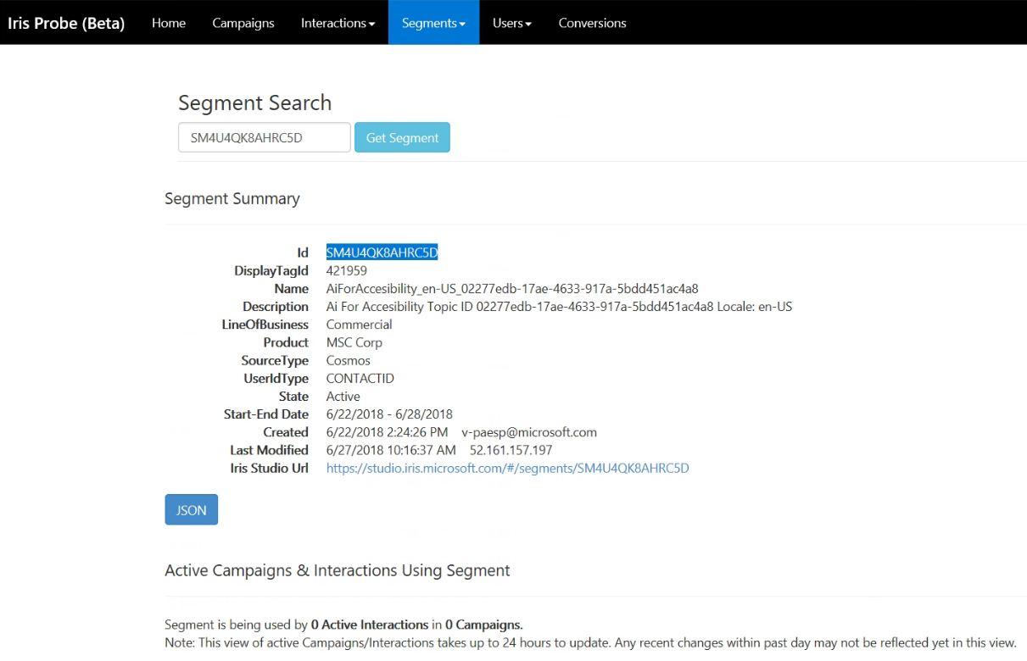

Slide 15
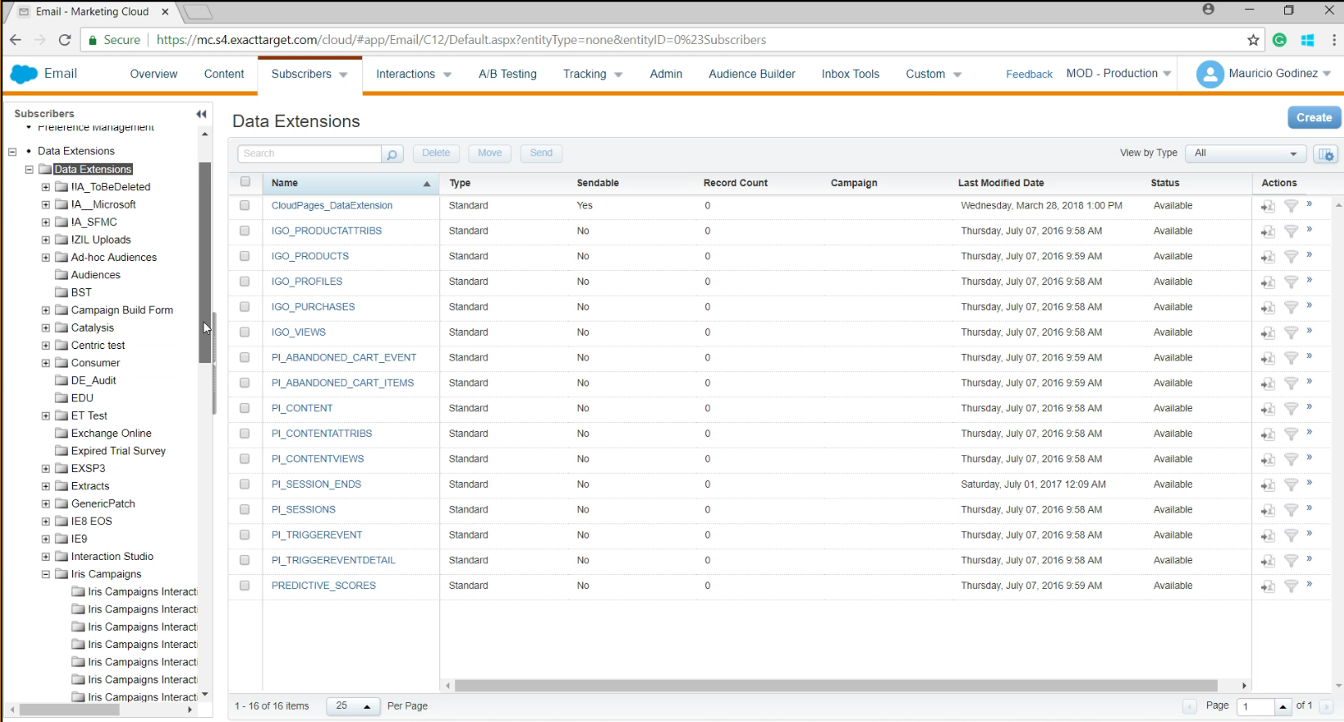

Slide 16
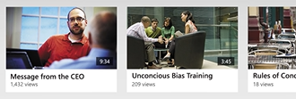
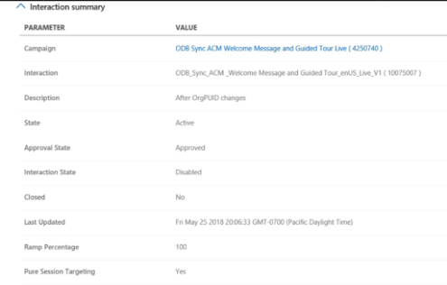
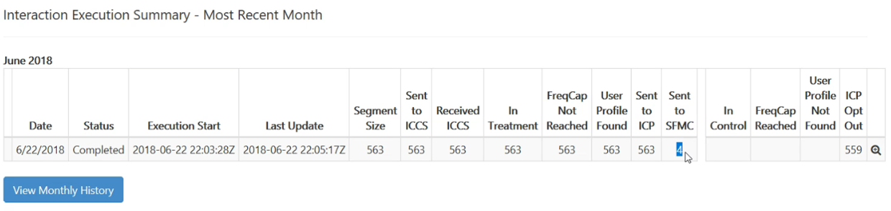
Yes, this is correct
No, this is not correct

Slide 17

Rosa Li
Email: xingsuo.li@Aptlytech.com
Cell: 425-233-0323

